Slide 1
Seminar Roulette
Level 4 Project Presentation
Ollie Gardner | 2310049G
Notes:
Hello, my name is Ollie and today I’m going to talk to you about my level 4 project, Seminar Roulette, an event recommendation platform for university academics

Slide 2
Motivation
Notes:
Every week, the University of Glasgow host an average of 15.4 research seminars that are attended by staff and students. These seminar attendees are time-poor and do not want the hassle of trawling through lists of events to find the ones which are of interest to them. Academics are often unsure if a seminar will be of interest to them or not, so they will choose not to attend. Current systems used by the University are outdated and do not contain any personalised recommendation features. This project proposes a new web-based platform called Seminar Roulette that will provide academics with a unified approach to seminar organisation and management.

Slide 3


Background
Notes:
The e-commerce industry is growing by 23% every year and as a result, companies such as Netflix and Amazon are having to deploy new techniques to enable their users to benefit from personalised experiences on their platforms. Both companies reap the benefits of using algorithmic recommender systems to provide users with valuable movie and product suggestions. Currently, no platform exists within academia that takes advantage of these recommendation features.

Slide 4
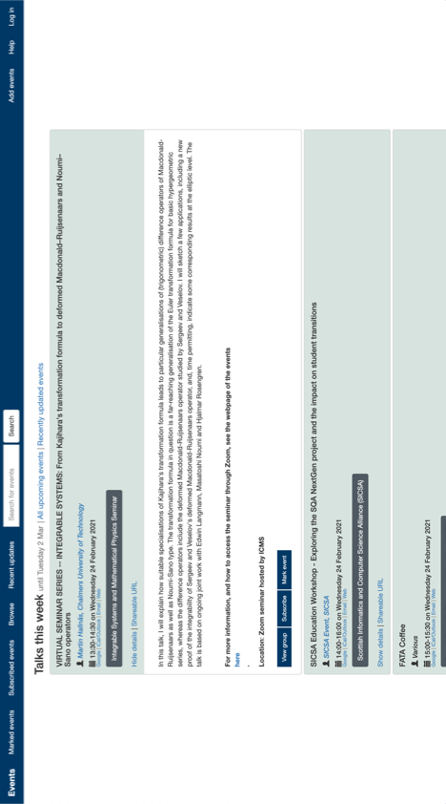
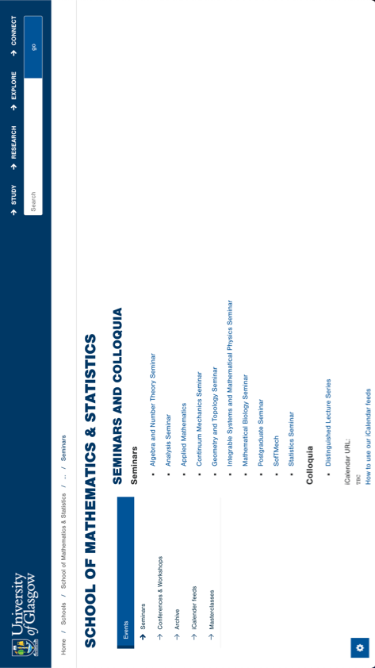
Background
Notes:
There are multiple related products that the University of Glasgow use for seminar management. Pictured at the top is a web application called Samoa Events, an internal system to the University that was developed by Andrew Ramsay. The platform was the first University of Glasgow system to collate event data from multiple sources and display them in the one place. The main limitation of Samoa Events is that it does not provide users with a personalised experience. The University also use their own website to advertise events such as the Mathematics and Statistics page. However, this is not a user-friendly method of browsing upcoming seminars because the process involves navigating around the entirety of the university’s website to find a suitable event.

Slide 5
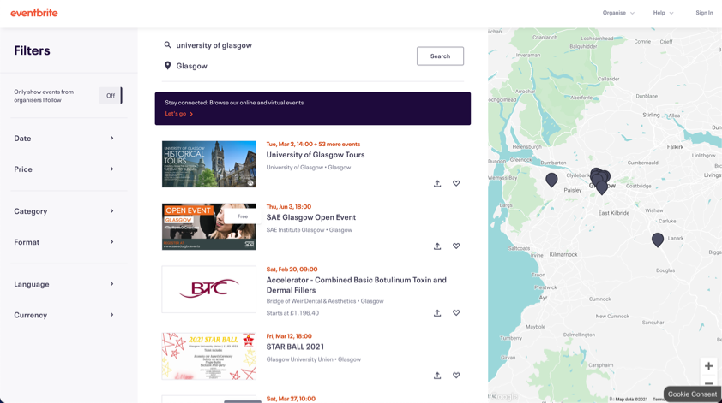
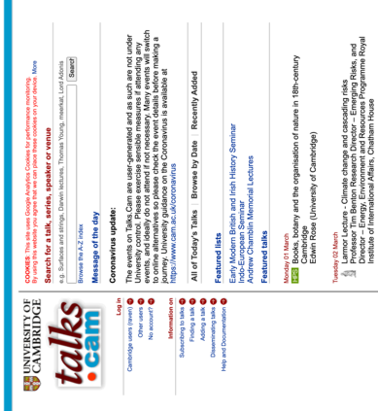
Background
Notes:
The University also use external platforms, such as Eventbrite to create and promote events happening on campus. In 2019, Eventbrite advertised over 4.7 million events on the platform and are now dominating the online events market. The major drawback of Eventbrite is that it was not specifically designed to advertise university research seminars. Moving away from the University of Glasgow, the University of Cambridge have their own inhouse platform called talks.cam to advertise seminars and talks taking place at Cambridge. There are many features that Seminar Roulette should use as inspiration. For example, the talks.cam platform can send daily or weekly reminders to its users regarding talks that they might be interested in.

Slide 6
Requirements
Generated user stories and created initial user survey to elicit requirements
Devised set of functional and non-functional requirements
Requirements then prioritised using MoSCoW
Ensure system can scale to 40,000 users
Notes:
Requirements for the project were generated through the use of user stories and also an initial user survey that was sent out to key stakeholders. Following this, a set of functional and non-functional requirements were devised and prioritised using the MoSCoW technique. This prioritised requirements into must have, should have, could have and won’t have this time. As of 2020, there are nearly 30,000 students and 8500 staff members at the University of Glasgow so it was imperative that Seminar Roulette could scale to handle at least 40,000 concurrent users.

Slide 7
Design
Notes:
Seminar Roulette was designed using a three-tier architecture approach. This is where components are structured into three logical and physical layers – presentation, application and data. Illustrated, is the system architecture diagram for Seminar Roulette, where the presentation layer was responsible for allowing users to interact with the system’s components. The application layer allowed for communication via RESTful API calls with the data layer. Finally, the data layer contained the information stored by the application through the use of a database.

Slide 8
Design
Notes:
Before implementation commenced, low-fidelity prototypes were drawn in the form of paper sketches. Following this, high-fidelity prototypes were creating using a wireframing tool called Balsamiq. This enabled for the final look and feel of the platform to be envisaged prior to development.

Slide 9
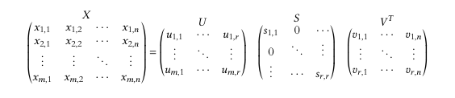
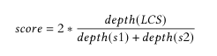
Design
Matrix Factorisation via Singular Value Decomposition
WuPalmer Similarity
Notes:
As one of Seminar Roulette’s aims was to provide academics with seminar recommendations, two algorithms were implemented to satisfy this requirement. The first utilised matrix factorisation via singular value decomposition and enabled seminar suggestions to be made to users based on how they have rated seminars that they have previously attended. This algorithm is heavily based off how Netflix handle their movie recommendations. On Seminar Roulette, users were able to give a seminar a star rating from 1 to 5 and using these ratings, the algorithm recommended similar future seminars. The platform also made use of the WuPalmer similarity algorithm which allowed a user to enter a list of their personal interests and in response, they were given a percentage value for how similar their interests are to the description of the seminar.

Slide 10










Implementation
Notes:
Throughout the project, various software engineering practices were used to aid the development of Seminar Roulette. Agile methodologies were followed and in particular a Kanban approach was taken to enable new features to be released whenever they were ready. To aid project management, Trello and GitHub were used. To build the frontend of Seminar Roulette, React was used. React is a JavaScript framework created by Facebook for building user interface components. On the backend, the Python-based web framework Django was used in conjunction with the Django Rest Framework to enable the backend and frontend to speak to each other through RESTful API calls. The relational database, Postgres, was used as the project’s database management system. Finally, the platform was deployed onto an Apache web server and utilised Shibboleth to enable to enable the University’s single sign-on to be used successfully. This allowed users to login to Seminar Roulette using their university GUID and password.

Slide 11
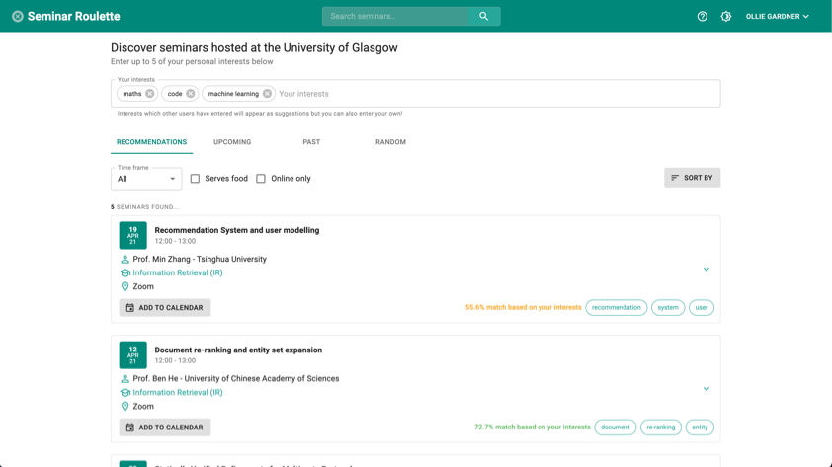
Final Product
Notes:
Here are some screenshots of the final software product. The first screenshot shows the main page once a user has logged in. Shown are the user’s seminar recommendations and they can navigate to upcoming, past and random using the tabs. They are also able to filter and sort seminars to suit their needs. Other features, such as add to calendar and a seminar’s keywords are also visible in this image.

Slide 12
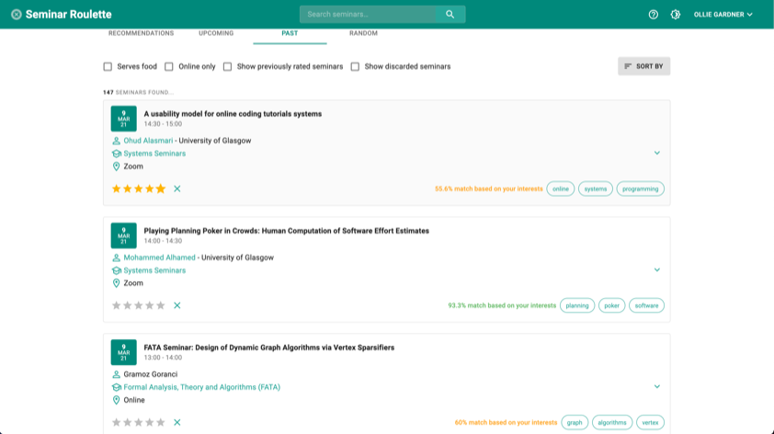
Final Product
Notes:
The second screenshot shows Seminar Roulette once the past tab has been clicked. This tab shows past seminars which the user can give a star rating of 1 to 5. Using these ratings, seminar recommendations are made to the user. These suggestions are updated each time a user rates a seminar.

Slide 13
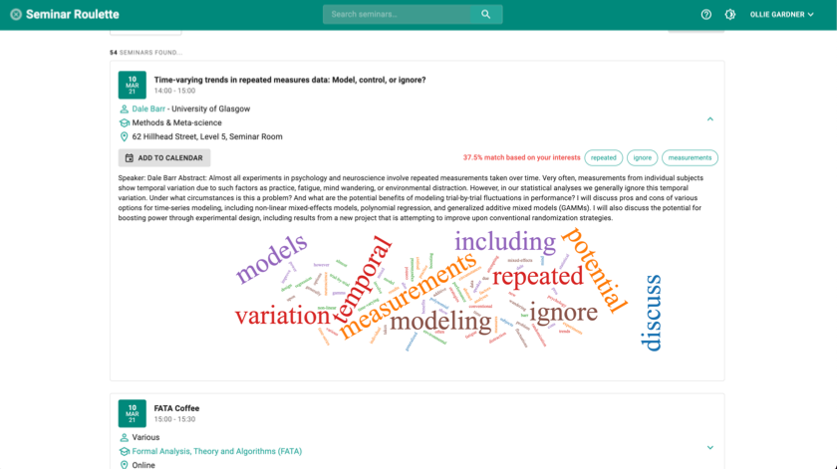
Final Product
Notes:
The third screenshot shows the seminar view once it has been clicked on. On click, the seminar card expands to reveal more information about the seminar. Specifically, it shows a description about the seminar and also a word cloud below. The word cloud shows the words in the description with the highest frequency so that the premise of the seminar can be visualised.

Slide 14
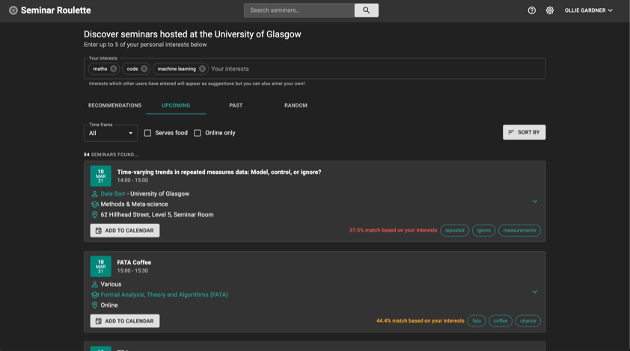
Final Product
Notes:
The final screenshot shows Seminar Roulette in dark mode. This setting can be activated from within the top navigation bar. Dark mode was implemented to the make the platform more accessible to colour blind users as it is estimated that there are around 253 million people in the world living with some sort of vision impairment.

Slide 15
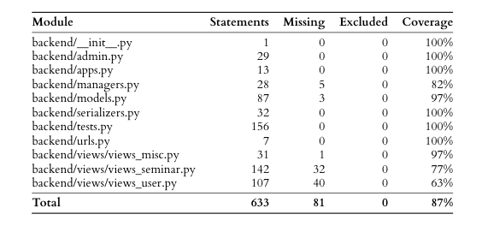
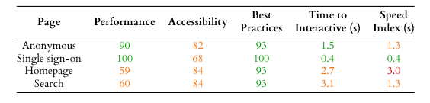
Evaluation
Notes:
An extensive evaluation was carried out to assess the usability and suitability of seminar roulette. A suite of unit tests was implemented to stop broken code from being pushed to production and an overall coverage of 87% was achieved by the unit tests. The performance of the system was also evaluated using Lighthouse, an auditing tool developed by Google that evaluates the performance of websites. The performance evaluation revealed some major performance regression issues with the platform as it was slow to load and become fully functional.

Slide 16
Evaluation
Notes:
Two end user evaluations of Seminar Roulette were carried out. The first of these being at the end of semester 1 in the form of a think-aloud evaluation. The aim of this evaluation was to steer the project in the right direction for semester 2 and to get feedback from participants on progress made so far. The think-aloud was carried out with 6 of the project supervisor’s postgraduate students who were all avid seminar attendees. Following this evaluation, a larger final user evaluation was carried out towards the end of the project with 34 participants. Within this evaluation, quantitative and qualitative data was collected. Participants were asked to complete a set of tasks on Seminar Roulette before filling in a questionnaire. The quantitative section was based on a Post Study System Usability Questionnaire which consisted of a standard set of 16 questions. The responses to these questions were measured on a 7-point Likert scale where 1 represented strongly agree and 7 indicated strongly disagree. Seminar Roulette scored an overall score of 1.9 implying that the platform is highly usable.

Slide 17
Evaluation
Notes:
The qualitative section of the questionnaire consisted of 5 open ended questions designed to further assess the suitability of Seminar Roulette and the understand the need for future work in future iterations of the platform. The 5th question asked participants to describe the overall design and functionality of Seminar Roulette in 5 words. A word cloud was used to visualise their responses. The most common words used were easy, clean, simple and intuitive showing that Seminar Roulette is visually pleasing and can be used without any prior training.

Slide 18
Reflection
Gained insight into inner workings of University of Glasgow systems
Build clean and responsive user interfaces
Deployed evaluative techniques potentially used within industry
Algorithmic recommender system
Accessibility to impaired users
Ensure platforms looks and feels like a University of Glasgow product
Notes:
This project has allowed me to gain a greater insight into the inner workings of University systems and learn how to build clean, responsive and functional user interfaces for deployed software. The evaluation process of the project was largely new to me, allowing me to realise how large-scale software products might be tested and evaluated within industry. It was also my first time developing an algorithmic recommender system within a software product which was huge learning curve, and a significant amount of time was spent researching the subject. If Seminar Roulette were to be built from scratch again, further initial research would be conducted into how to ensure that the system is accessible to users with impairments, as this is something that was overlooked within the design stage of the project. Furthermore, more attention would be given to the colour scheme and design, ensuring that the platform looks and feels like a University software product.

Slide 19
Future Work
Address performance issues
Implement could have requirements
Extend functionality to more event feeds e.g. Bookitbee, Yammer and Meetup
White label Seminar Roulette to enable other academic institutions to use it
Notes:
A multitude of work could be undertaken to extend the functionality of Seminar Roulette in the future. However, before additional features could be implemented, the short-term goal would be to address the current performance issues to ensure that the platform is efficient as possible. Following this, Seminar Roulette would be extended to include more data feeds from other University systems, such as Bookitbee, Yammer and Meetup. In future iterations of Seminar Roulette, the software could be re-targeted for other academic institutions. This process is known as white labelling, where a product is produced that has the capability to be re-branded to suit any requirements.

Slide 20
Thank you!
Notes:
Thanks for listening!

